Slide 1
Principles and Practices of Management
UNIT-IV

Slide 2

Leadership Styles & Development

Slide 3
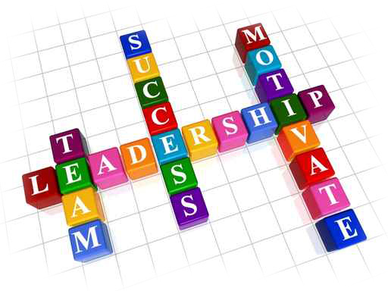
LEADERSHIP
Leader is someone who help others do and become what they ever thought possible.
Leadership is all about courage to dream big.
Leadership which helps to maximize efficiency and to achieve organizational goals.

Slide 4
LEADERSHIP
A leader is someone who brings people together.
Leader – Someone who can influence others and who has managerial authority
Leadership is the capacity to translate vision into reality.
The best example of leadership, is leadership by example.

Slide 5
LEADERSHIP
Managers are the people who do things right , while leaders are the people who do right things.
“Management is doing things right, leadership is doing the right things”
(Warren Bennis and Peter Drucker)
Leadership – What leaders do; the process of influencing a group to achieve goals
Ideally, all managers should be leaders
Give people a reason to come to work.
Be loyal to the organization’s people.
Spend time with people who do the real work of the organization.

Slide 6
LEADERSHIP
Required at all levels- Leadership is a function which is important at all levels of management.
Leadership can be exercised through guidance and counseling of the subordinates at the time of execution of plans.
Representative of the organization- A leader, i.e., a manager is said to be the representative of the enterprise.
He has to represent the concern at seminars, conferences, general meetings, etc.

Slide 7
LEADERSHIP
As a friend, philosopher and guide- A leader must possess the three dimensional traits in him.
He can be a friend by sharing the feelings, opinions and desires with the employees.
He can be a philosopher by utilizing his intelligence and experience and thereby guiding the employees as and when time requires.
He can be a guide by supervising and communicating the employees the plans and policies of top management and secure their co-operation to achieve the goals of a concern.
he can also play the role of a counselor by counseling and a problem-solving approach. He can listen to the problems of the employees and try to solve them.

Slide 8
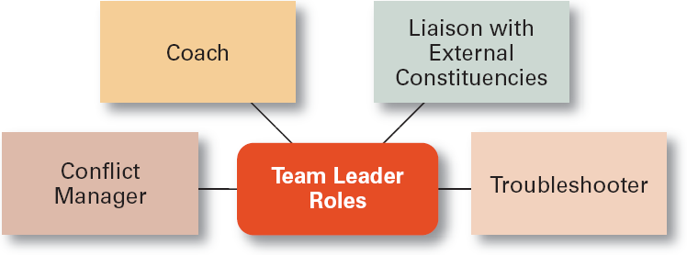
Specific Team Leadership Roles

Slide 9
LEADERSHIP
Great Leaders
Live with integrity, lead by example
develop a winning strategy or “big idea”
build a great management team
inspire employees to greatness
create a flexible, responsive organization
passionate about what they do
love to talk about it
high energy, clarity of thinking
communicate to diverse audience
work through people (empowering)

Slide 10
Leaders vs. Managers
LEADERS:
  innovate
  focus on people
  inspire trust
  have a long-range view
  ask what and why
  have eyes on horizon
  originate
  do the right thing
MANAGERS:
  administrate
  focus on systems and structures
  rely on control
  have a short-range view
  ask how and when
  have eyes on bottom line
  initiate
  do things right

Slide 11
Suggestions for Building Trust
Practice openness.
Be fair.
Speak your feelings.
Tell the truth.
Show consistency.
Fulfill your promises.
Maintain confidences.
Demonstrate competence.

Slide 12
LEADERSHIP STYLES
Leadership style is the manner and approach of providing direction, implementing plans, and motivating people.
It is the result of the philosophy, personality, and experience of the leader
It is the art or process of influencing people so that they contribute willingly towards group goal.

Slide 13
LEADERSHIP STYLES
Autocratic or paternalistic or Authoritarian
Participative or democratic
Delegative or Free Reign (period of influence) or “hands-off¨ or free-rein style

Slide 14


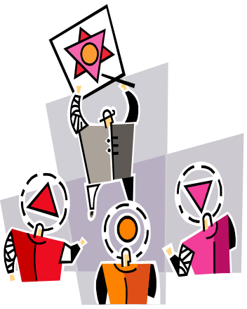

TYPES OF LEADERSHIP
AUTOCRATIC
DELEGATIVE
BUREAUCRATIC
DEMOCRATIC

Slide 15
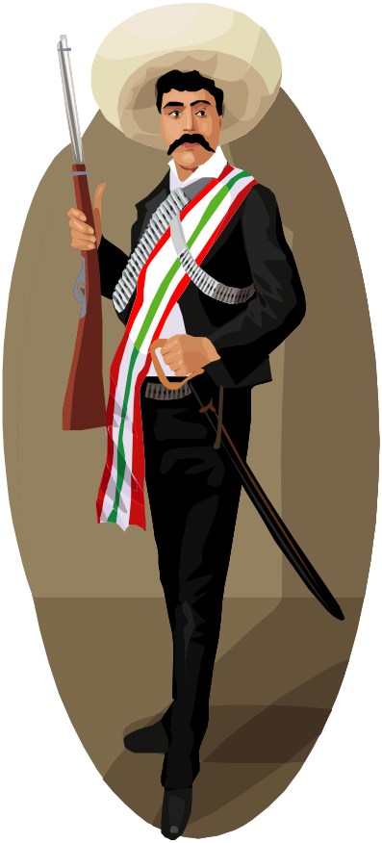
AUTOCRATIC
“I want both of you to...”
The classical approach.
Manager retains power
Manager does not consult employees for input
Subordinates expected to obey orders without explanations
Rely on threats, fear, pressure and punishment to influence staff
One way communication
      centralized authority, low participation

Slide 16
When to use Autocratic
New, untrained employees
Employees do not respond to any other leadership style
High-volume production needs
Limited time for decision making
Manager’s power is challenged by an employee

Slide 17

DEMOCRATIC
“Let's work together to solve this…”
Often referred to as participative style
Encourages staff to be a part of the
decision making
Keeps employees informed
The leader maintains the final decision
It is a style of mutual benefit
Shares decision making and problem solving responsibilities.
Can produce high quality and high quantity work for long periods of time
      Democratic style: involvement, high participation, feedback

Slide 18
When to use Democratic
To keep employees informed.
To encourage employees to share in decision-making and problem-solving.
To provide opportunities for employees to develop a high sense of personal growth and job satisfaction.
Complex problems that require a lots of input.
To encourage team building and participation

Slide 19
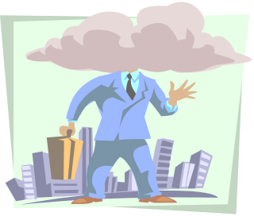
DELEGATIVE
“You two take care of the problem while I go…”
Also known as the “hands-off¨ or free-rein style or complete authority to subordinates.
In this type of leadership style, the leadership responsibilities are shared by all i.e. by employees also.
Little or no direction.
Gives followers as much freedom as possible.
All authority or power is given to the followers.
Followers must determine goals, make decisions, and resolve problems on their own.

Slide 20
When to use Delegative
Employees are highly skilled, experienced, and educated.
Employees have pride in their work and the drive to do it successfully on their own.
Outside experts, such as staff specialists or consultants are being used.
Employees are trustworthy, honest, reliable and experienced.

Slide 21

BUREAUCRATIC
Manages “by the book¨
Everything done according to procedure or policy
In this style, the leader enforces the rules.
If not covered by the book, referred to the next level above
A police officer not a leader,
Enforces the rules.

Slide 22
When to use BUREAUCRATIC
Performing routine tasks
Need for standards/procedures
Use of dangerous or delicate equipment
Safety or security training being conducted
Tasks that require handling cash

Slide 23
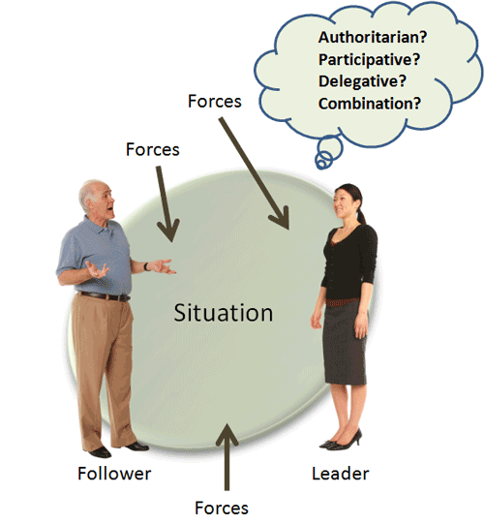

Slide 24
Forces that influence the style
Forces that influence the style to be used included:
How much time is available.
Are relationships based on respect and trust or on disrespect?
Who has the information — you, your employees, or both?
How well your employees are trained and how well you know the task.
Internal conflicts.
Stress levels.
Type of task. Is it structured, unstructured, complicated, or simple?

Slide 25
Forces that influence the style
There is a difference in ways leaders approach their employee.
Positive leaders use rewards, such as education, independence, etc. to motivate employees.
While negative employers stress penalties loss of job, days off without pay, lecturing employees in front of others, etc.

Slide 26
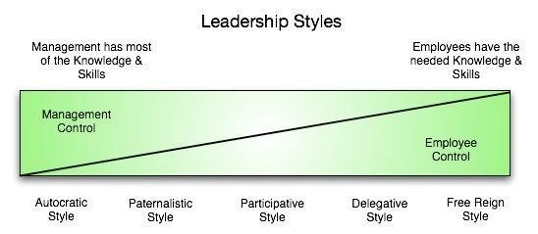
Forces that influence the style

Slide 27

A leader is…
Self starter
Visionary
Motivator
Communicator
Mentor
Risk taker
Strategic thinker
committed
responsible

Slide 28
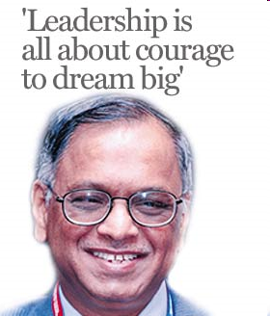
A leader is…
Bill Gates
Bill Gates is consistently the richest man in the world; and the co-founder of Microsoft, the creator of the commonly used Windows.
He is best known for being the entrepreneur that revolutionized the computer industry.

Slide 29
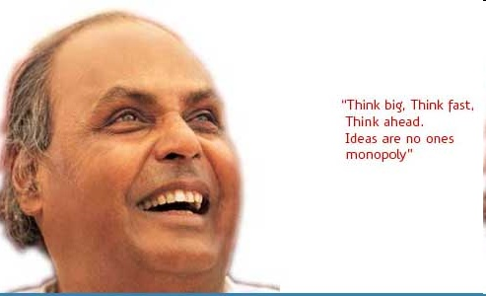
A leader is…
"Think big, think fast, think ahead. Ideas are no one's monopoly"
"If you work with determination and with perfection, success will follow."
"We cannot change our Rulers, but we can change the way they Rule Us."

Slide 30
LEADERSHIP DEVELOPMENT
Develop a relationship
frequent personal contact. LISTEN to others.
Take time to learn & understand other people’s needs.
Positive approach
Plan b4 u speak. Avoid jumping 2 conclusions.
Keep –ve emotion out of discussion.
Complaints/suggestions
View complaints not as personal criticism but as valuable feedback & suggestions.
Not easy 2 do but working relationships improved when
regularly practiced.
Explain why
Be truthful. Show willingness to answer the questions.

Slide 31
CONTD..
Promises
Make few promises and keep them!
Credibility lost, when leadership fails to keep promises.
Admit mistakes
Recognize no1 is perfect.
No mistakes=>is employee or leader really doing anything? Atleast not taking the risks.
Document “LESSONS LEARNED” 4 each project.
Compliment
Always give recognition where deserved.
Recognition can be simple , a note of thanks.
Teamwork doesn’t just happen!
Takes time , effort to establish effective team.
Team leader often not the “boss”.

Slide 32
THE MOST IMPORTANT WORDS
The six most important words: "I admit I made a mistake."
The five most important words: "You did a good job."
The four most important words: "What is your opinion."
The three most important words: "If you please."
The two most important words: "Thank you,"
The one most important word: "We"
The least most important word: "I“
Remember, Leadership is Action, not Position
  Power does not make you a leader...it simply makes you the boss.

Slide 33
Early Leadership Theories
Trait Theories (1920s-30s)
  Research focused on identifying personal characteristics that differentiated leaders from non-leaders was unsuccessful.
  Later research on the leadership process identified seven traits associated with successful leadership:
    Drive, the desire to lead, honesty and integrity, self-confidence, intelligence, job-relevant knowledge, and extraversion.

Slide 34
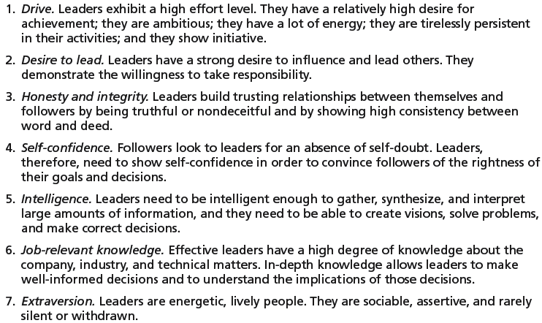
Seven Traits Associated with Leadership

Slide 35
Contingency Theories… (cont’d)
Path-Goal Model
  States that the leader’s job is to assist his or her followers in attaining their goals and to provide direction or support to ensure their goals are compatible with organizational goals.
  Leaders assume different leadership styles at different times depending on the situation:
    Directive leader
    Supportive leader
    Participative leader
    Achievement oriented leader

Slide 36
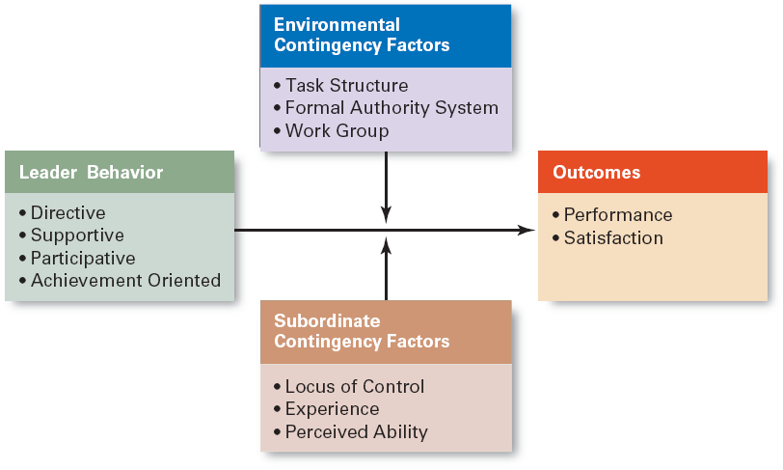
Path-Goal Theory

Slide 37
Leadership Issues in the 21st Century
Managing Power
  Legitimate power
    The power a leader has as a result of his or her position.
  Coercive power
    The power a leader has to punish or control.
  Reward power
    The power to give positive benefits or rewards.
  Expert power
    The influence a leader can exert as a result of his or her expertise, skills, or knowledge.
  Referent power
    The power of a leader that arise because of a person’s desirable resources or admired personal traits.

Slide 38
Developing Credibility and Trust
Credibility (of a Leader)
  The assessment of a leader’s honesty, competence, and ability to inspire by his or her followers
Trust
  Is the belief of followers and others in the integrity, character, and ability of a leader.
    Dimensions of trust: integrity, competence, consistency, loyalty, and openness.
  Is related to increases in job performance, organizational citizenship behaviors, job satisfaction, and organization commitment.

Slide 39
Providing Ethical Leadership
Ethics are part of leadership when leaders attempt to:
  Foster moral virtue through changes in attitudes and behaviors.
  Use their charisma in socially constructive ways.
  Promote ethical behavior by exhibiting their personal traits of honesty and integrity.
Moral Leadership
  Involves addressing the means that a leader uses to achieve goals as well as the moral content of those goals.

Slide 40
Empowering Employees
Empowerment
  Involves increasing the decision-making discretion of workers such that teams can make key operating decisions in develop budgets, scheduling workloads, controlling inventories, and solving quality problems.
  Why empower employees?
    Quicker responses problems and faster decisions.
    Addresses the problem of increased spans of control in relieving managers to work on other problems.

Slide 41
Selected Cross-Cultural Leadership Findings
Korean leaders are expected to be paternalistic toward employees.
Arab leaders who show kindness or generosity without being asked to do so are seen by other Arabs as weak.
Japanese leaders are expected to be humble and speak frequently.
Scandinavian and Dutch leaders who single out individuals with public praise are likely to embarrass, not energize, those individuals.
Effective leaders in Malaysia are expected to show compassion while using more of an autocratic than a participative style.
Effective German leaders are characterized by high performance orientation, low compassion, low self-protection, low team orientation, high autonomy, and high participation.

Slide 42
COMMUNICATION

Slide 43
Learning Objectives
What is Communication?
Functions, Nature and Role of Communications
Communication network
Types of Communication
Barriers of Effective Communication
Achieving Effective Communications

Slide 44
What Is Communication?
Communication is the sum of all the things a person does when he wants to create understanding in the mind of others.
Involves a systematic and continuous process of telling, listening and understanding.
The success of any business to a large extent depends on the system of communication.
Communication can be defined as the process by which people share ideas, experience, knowledge and feelings through the transmission of symbolic messages.
  Interpersonal Communication
    Communication between two or more people
  Organizational Communication
    All the patterns, network, and systems of communications within an organization

Slide 45
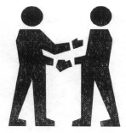
What is Communication?
The means of communication are usually spoken or written words, pictures or symbols.
But we also give information through body language, gesture or sign or signals and looks, facial expressions can show how we feel and what we think about an issue or another person.

Slide 46
What are the most common ways
we communicate?
Visual Images
Spoken Word
Written Word
Body Language

Slide 47
Characteristics of effective Communications
Effective communication requires the message to be:
Clear and concise or short
Accurate
Relevant to the needs of the receiver
Timely
Meaningful
Applicable to the situation

Slide 48
Four Functions of Communication
Control
Motivation
Functions of
Communication
Information
Emotional
Expression

Slide 49
Functions of Communication
Control
  Formal and informal communications act to control individuals’ behaviors in organizations.
Motivation
  Communications clarify for employees what is to done, how well they have done it, and what can be done to improve performance.
Emotional Expression
  Social interaction in the form of work group communications provides a way for employees to express themselves.
Information
  Individuals and work groups need information to make decisions or to do their work.

Slide 50
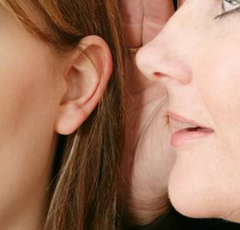
Communication Key Elements
Message
  Source: sender’s intended meaning
Encoding
  The message converted to symbolic form
Channel
  The medium through which the message travels
Decoding
  The receiver’s retranslation of the message
Noise
  Disturbances that interfere with communications

Slide 51
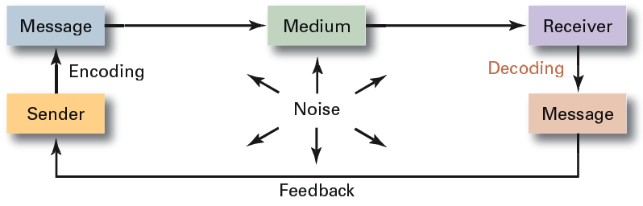
The Interpersonal Communication Process

Slide 52
The Communication Process
Medium
Barrier
SENDER
(encodes)
Barrier
RECEIVER
(decodes)
Feedback/Response

Slide 53
The Communication Process
Message Encoding
  The effect of the skills, attitudes, and knowledge of the sender on the process of encoding the message
  The social-cultural system of the sender
The Message
  Symbols used to convey the message’s meaning
  The content of the message itself
  The choice of message format(Audio, video, text, image etc.)

Slide 54
The Communication Process
The Channel
  The sender’s choice of the appropriate channel or multiple channels for conveying the message
Receiver
  The effect of skills, attitudes, and knowledge of the receiver on the process of decoding the message
  The social-cultural system of the receiver
Feedback Loop
  Communication channel alterations affecting the return message from receiver to sender

Slide 55
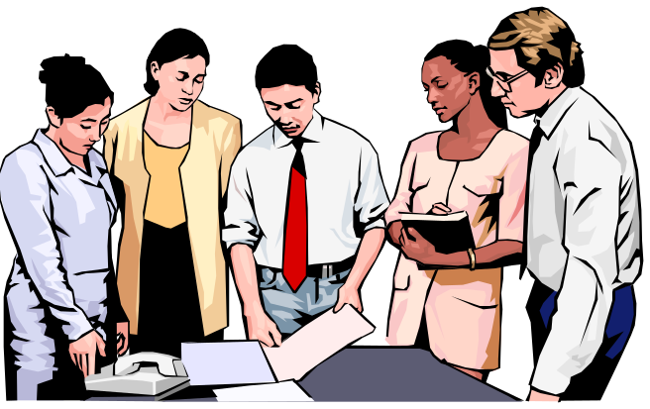
Interpersonal Communication Methods
Face-to-face
Telephone
Group meetings
Formal presentations
Memos
Traditional Mail
Fax machines
Employee publications
Bulletin boards
Audio- and videotapes
Hotlines
E-mail
Computer conferencing
Voice mail
Teleconferences
Videoconferences

Slide 56
Evaluating Communication Methods
Feedback
Confidentiality
Encoding Simplicity
Decoding Simplicity
Cost
Interpersonal warmth or kindness
Time consumption

Slide 57

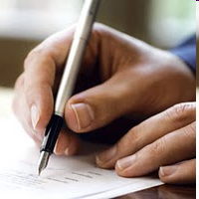
Oral communication
Written communication
  Body language: gestures, facial expressions, and other body movements that convey meaning.

Slide 58
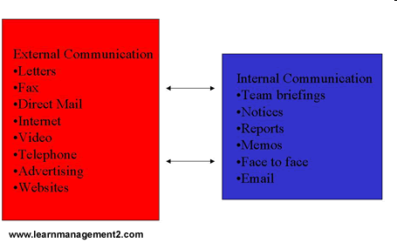
Written communication

Slide 59


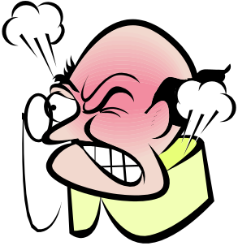

Barriers to communication
Language
Values and beliefs
Sex/gender and age
Economic status
Educational level
Attitude
Timing
Understanding of message
Trust

Slide 60
Interpersonal Communication Barriers
Filtering
National
Culture
Emotions
Language
Interpersonal Communication
Information
Overload
Defensiveness

Slide 61
Barriers to Effective Interpersonal Communication
Filtering
  The Planned manipulation of information to make it appear more favorable to the receiver.
Emotions
  Ignore normal and objective thinking processes and substituting emotional judgments when interpreting messages.
Information Overload
  Tackle with a quantity of information that exceeds an individual’s capacity to process it.
Defensiveness
  When in danger, reacting in a way that reduces the ability to achieve mutual understanding.

Slide 62
Barriers to Effective Interpersonal Communication (cont’d)
Language
  The different meanings of and specialized ways (Terminology) in which senders use words can cause receivers to misinterpret their messages.
National Culture
  Culture influences the form, formality, openness, patterns and use of information in communications.

Slide 63

Overcoming the Barriers to Effective Interpersonal Communications
Use Feedback
Simplify Language
Listen Actively
Restrict Emotions
Watch Nonverbal signal

Slide 64
Types of Organizational Communication
Formal Communication
  Communication that follows the official chain of command or is part of the communication required to do one’s job.
Informal Communication
  Communication that is not defined by the organization’s hierarchy.
    Permits employees to satisfy their need for social interaction.
    The grapevine, gossip, rumor, chit-chat is an informal channel through which rumors and unofficial information pass.

Slide 65
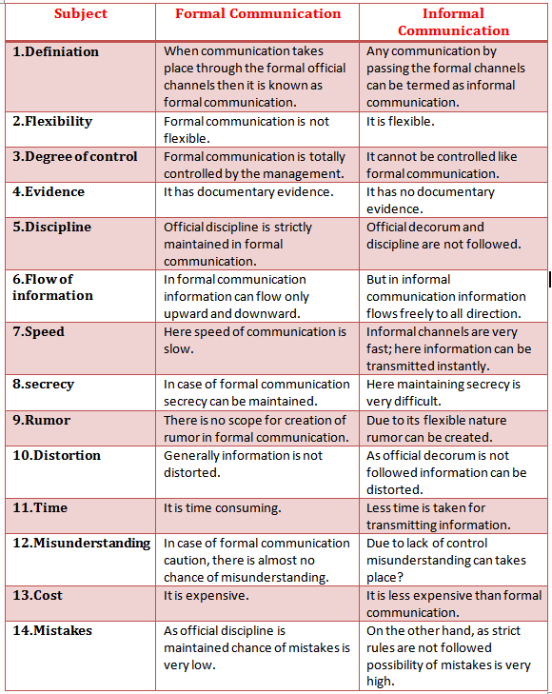

Slide 66
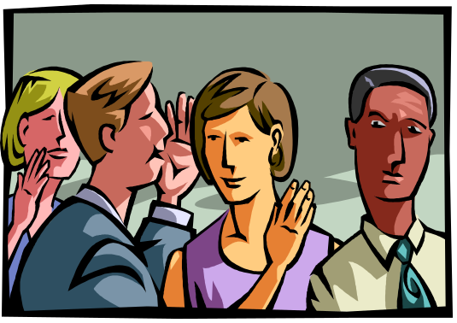
The Grapevine
An informal organizational communication network that is active in almost every organization.
  Provides a channel for issues not suitable for formal communication channels.
  The impact of information passed along the grapevine/gossip can be countered by open and honest communication with employees.

Slide 67
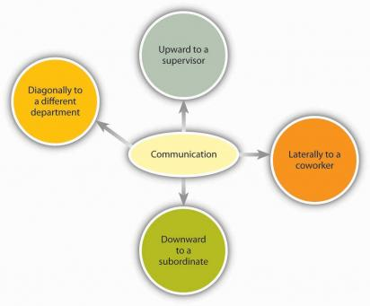

Communication Flows
Diagonal
Upwa
r
d
Downwa
r
d
Lateral

Slide 68
Communication Flows
Downwards Communication : Highly Directive, from Senior to subordinates, to assign duties, give instructions, to inform to offer feed back, approval to highlight problems etc.
  The flow of information follows the chain of command from top to bottom.
    Strategies.
    Objectives.
    Instructions.
    Policies.
    Orders
    commands

Slide 69
Communication Flows
Upwards Communications : It is non directive in nature from down below, to give feedback, to inform about progress/problems, seeking approvals.
  The flow of information from lower to higher levels of the organization.
  Upward communication informs higher level personnel about lower level workers’:
    Problems.
    Results.
    Suggestions.
    Questions.
    Needs.

Slide 70

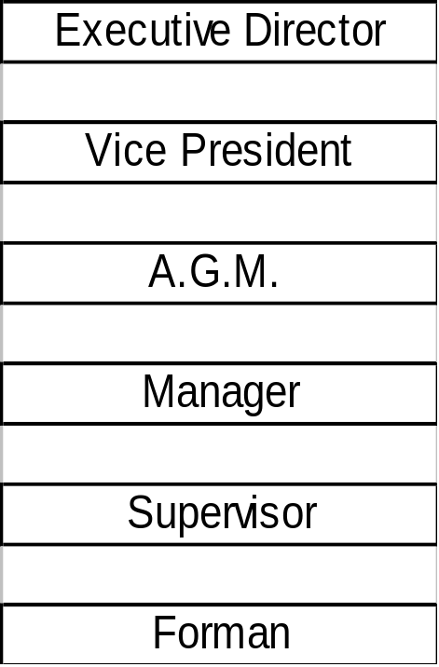
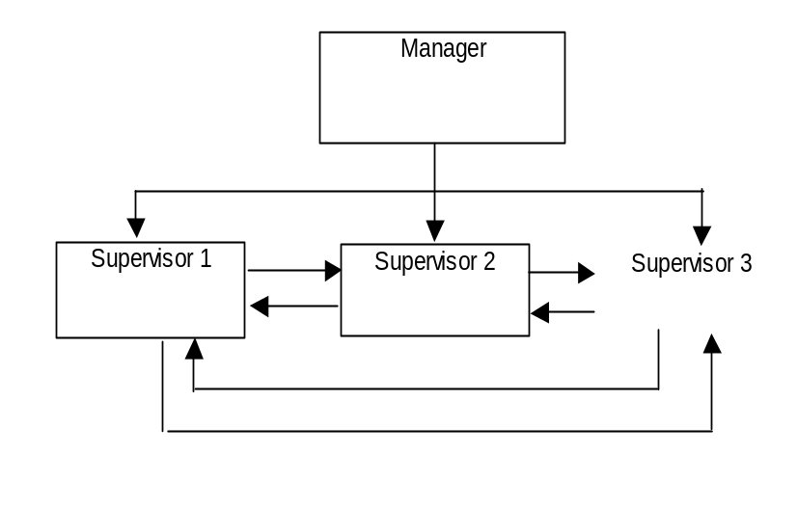
HIERARCHY LEVEL
Downward Comm.
Horizontal Comm.

Slide 71
Communication Flows
Lateral or Horizontal Communication: Among coworkers, peers at same level for information level for information sharing for coordination, to save time.
  The flow of information across persons or work units at the same hierarchical level.
  Lateral communication allows persons and work units to coordinate:
    Problems.
    Needs.
    Advice.
    Feedback.

Slide 72
Direction of Communication Flow (cont’d)
Diagonal Communication
  Communication that cuts across both work areas and organizational levels in the interest of efficiency and speed.

Slide 73
Types of Communication Networks
Chain Network
  Communication flows according to the formal chain of command, both upward and downward.
Wheel Network
  All communication flows in and out through the group leader (hub) to others in the group.
All-Channel Network
  Communications flow freely among all members of the work team.

Slide 74
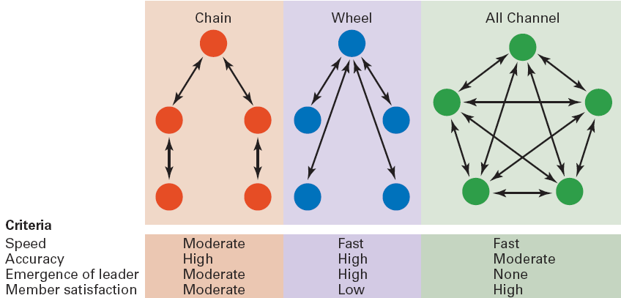
Three Common Organizational Communication Networks and How They Rate on Effectiveness Criteria

Slide 75
How IT Affects Organization
sharing of information Increases effectiveness and efficiency
Linking individual computers to create an organizational network for communication and information sharing.
Removes the constraints of time and distance
Allows widely dispersed employees to work together.
Provides more complete information and participation for better decisions.

Slide 76
How IT Affects Organization
E-mail
Instant messaging (IM)
Blogs
Voice-mail
Fax machines
Electronic Data Exchange (EDI)
Teleconferencing
Videoconferencing
Web conferencing
LAN,WAN,MAN
Intranet
Social networking sites
Yahoo groups etc..

Slide 77

Current Communication Issues
Managing Communication in an Internet World
  Legal and security issues
    Inappropriate use of company e-mail and instant messaging
    Loss of confidential and proprietary information due to chance or planned broadcasting or to hackers.
  Lack of personal interaction
    Being connected is not the same as face-to-face contact.

Slide 78
Terms to Know
Communication
Interpersonal communication
Organizational communication
message
encoding
channel
decoding
communication process
noise
nonverbal communication
lateral communication
diagonal communication
communication networks
grapevine
body language
verbal tone
Filtering
information overload
active listening
formal communication
informal communication
downward communication
upward communication
e-mail

Slide 79
Controlling: Process and Techniques

Slide 80
Learning Objectives
Concept, Nature and Importance of Control
Elements of Control Process
Requirement of Effective Control
Control by Exception

Slide 81
Definition of Control
According to Henry Fayol, “Control consists in verifying whether everything occurs in agreement with the plan adopted, the instruction issued and principles established.”
Planning without Control is Meaningless and Control without Planning is Blind.
Controlling ensure better measurement of organizational performance.
Elements of Control
Establishment of Standards [Planning].
Operations [Organizing, Staffing & Directing].
Measurement of Performance.
Comparing Performance with standards.
Taking Corrective actions

Slide 82
Features of Control
Managerial Function
Pervasive Function
Review of past events / Feedback
Forward Looking
Continuous Process
Dynamic Process
Action Oriented / Corrective Action
It serves as the guide for the worker about permissible deviations from the standard.
Control is based on facts

Slide 83
The Organizational Control Process
Controlling as a process involves following steps:
1.Establishment of standards- Measurable or tangible - They can be in form of cost, output, expenditure, time, profit, etc.
Non-measurable or intangible-performance of a manager, variation of workers, their attitudes towards a concern.
2.Measurement of performance
3.Comparison of actual and standard performance
4.Taking corrective actions

Slide 84
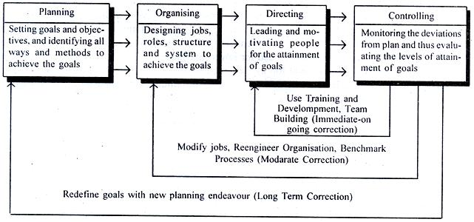
The Organizational Control Process

Slide 85
Kinds of Control
Historical Control.
Predictive / Feed forward Control.
Concurrent / Real time/ navigation Control .
Historical Control:
It measures results after the happening of an event.
It tell management to what extent objectives are actually achieved.
Example: Budgetary & Financial Control.

Slide 86
Kinds of Control
. 2. Predictive Control:
It attempts to predict or expect problems before they actually occur i.e; Prevention is better than Cure policy applied.
Example: idea of shortage of a particular raw material needed for production can be arranged well in advance.
3.Concurrent Control:
It is concerned with the adjustment of performance before any major damage is done like navigator of a ship adjusts his movement continuously in the right direction of the destination.
Example: Immediate corrective action taken before something controversial has been published.

Slide 87
Advantages of Control
Control brings order in the organization. Absence of control means Disorder, performance loss etc.
It helps in improving the performance of the subordinates.
It ensures better utilization of all types of resources that contributes to the progress of business.
Control points out or indicate the shortcomings of planning as well as other function of management such as organizing, staffing and directing.
Preventive steps will reduce the chances of mistakes being repeated in future.

Slide 88
Limitations of Control
An enterprise can not control the external factor such as government policy, technological changes, fashion changes, international trade etc.
Control may block the initiatives of subordinates or reduce their spirit.
The effectiveness of controls mainly depends on their acceptance by the subordinates.
Control is an expensive process that consumes lots of money, time and effort.
Measurable standards or Standard are essential to control but many aspects of business like goodwill, reputation, employee morale or public relations cannot be measured in quantitative terms.

Slide 89
Requirements of Effective Control
Emphasis on objectives.
Direct Control.
Flexibility.
Corrective actions.
Control by Exceptions.
Self Control.
Forward Looking Control.
Consideration of Human factors.

Slide 90
Control by Exception
An important aspect of management.
It concentrate only on key areas of activity on which the entire organization’s performance depends.
Only significant deviations (i.e. exceptions) from standards of performance should be brought to the management attentions.
An attempt to go through all deviations tend to increase unnecessary work and decrease attention on important problems.
Example: Increasing transportation cost or raw material cost affect the price of final goods more than the paper or postal cost increment.

Slide 91
TQM
Total - made up of the whole
Quality - degree of excellence a product or service provides
Management - act, art or manner of planning, controlling, directing,….
Therefore, TQM is the art of managing the whole to achieve excellence.

Slide 92
TQM
Total Quality Management
TQM is a philosophy which applies equally to all parts of the organization.
TQM can be viewed as an extension of the traditional approach to quality.
TQM places the customer at the forefront of quality decision making.
Greater emphasis on the roles and responsibilities of every member of staff within an organization to influence quality.
All staff are empowered.

Slide 93
What’s the goal of TQM?
“Do the right things right the first time, every time.”
TQM is all managers leading and facilitating all contributors in everyone’s two main objectives:
(1) total client satisfaction through quality products and services; and
(2) continuous improvements to processes, systems, people, suppliers, partners, products, and services.

Slide 94
The TQM System
Objective
Continuous
Improvement
Principles
Customer
Focus
Process
Improvement
Total
Involvement
Leadership
Education and Training Supportive structure
Communications Reward and recognition
Measurement
Elements

Slide 95
Organizational Change and Development

Slide 96
Organizational change
Organizational change is the movement of an organization away from its present state and toward some desired future state to increase its effectiveness
  Any alterations in the people, structure, or technology of an organization
  Businesses are now operating in a rapidly changing markets and conditions.
  Pressure from competitors and various external changes is forcing businesses to respond to change and make changes to their existing operations.

Slide 97
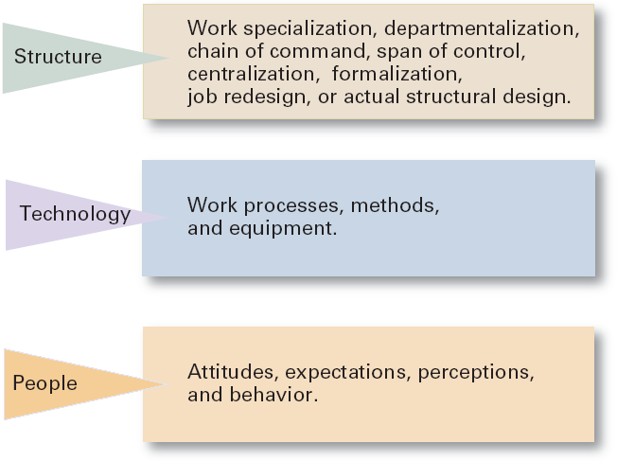
Three Categories of Change

Slide 98
Types of Change
Structural
  Changing an organization’s structural components or its structural design
Technological
  Adopting new equipment, tools, or operating methods that displace old skills and require new ones
    Automation: replacing certain tasks done by people with machines
    Computerization
People
  Changing attitudes, expectations, perceptions, and behaviors of the workforce
Organizational development (OD)
  Techniques or programs to change people and the nature and quality of interpersonal work relationships.

Slide 99
The Eight-Stage Process Of Change
• Initiation :need to change
• Motivation: involving people in detailed consideration of the proposed change
• Diagnosis :searching for main cause of symptom
Information collection :about diagnosis and development of alternative approaches
• reflection: evaluating alternatives
• Action proposal
• Implementation :translating proposed ideas into action
• Stabilization :internalizing the change and making it a part of the organization’s life

Slide 100
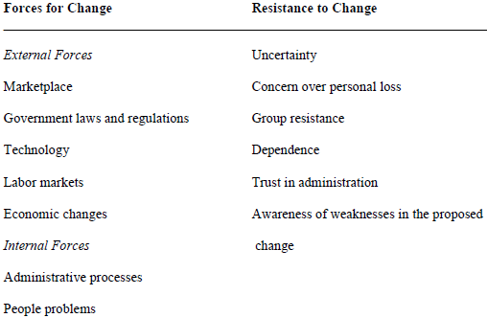
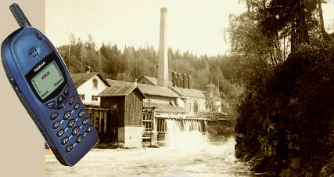
Some External Forces for Change
Information
Technology
Globalization
& Competition
Demography

Slide 101
Changing People: Some Basic Steps
Incorporating the changes,
creating and maintaining a
new organizational system
Step 3: Refreezing
Attempting to
create a new state
of affairs
Step 2: Changing
Current State New State
Recognizing the
need for change
Step 1: Unfreezing

Slide 102

Basic stages of implementing change
Unfreezing stage
Breaking from the old ways of doing things, unfreezing the old organizational culture by communication
Moving stage
Instituting or establishing the change, establishing a vision for change direction, and directing people to the change
Refreezing stage
Reinforcing and supporting the new ways, strengthening and supporting the change by providing new control and rewarding systems
© PhotoDisc

Slide 103

Basic stages of implementing change
Figure:
Stage one
Stage two
Stage three
Unfreezing
Moving
Refreezing

Slide 104
Managing Resistance to Change
Why People Resist (oppose, refuse to accept) Change?
  The ambiguity and uncertainty that change introduces
  The comfort of old habits
  A concern over personal loss of status, money, authority, friendships, and personal convenience
  The perception that change is incompatible with the goals and interest of the organization

Slide 105
Resistance To Change
Individual resistance
• Habit
• Security
• Economic factors
• Fear of the unknown
• Selective information processing
Organizational resistance
  • Structural inactivity
  • Limited focus of change
  • Group inactivity
  • Threat or risk or danger to expertise
  • Threat to established power relationships
  • Threat to established resource allocations

Slide 106
Managing Resistance to Change
Overcoming resistance to change
• Education and communication
  • Participation
• Facilitation and support
  • Negotiation

Slide 107
Strategies for Managing Cultural Change
Set the tone through management behavior; top managers, particularly, need to be positive role models.
Create new stories, symbols, and habits to replace those currently in use.
Select, promote, and support employees who adopt the new values.
To encourage acceptance of the new values, change the reward system.
Replace unwritten norms with clearly specified expectations.
Work to get agreement through employee participation and creating a climate with a high level of trust.

Slide 108
Characteristics of Change-Capable Organizations
Link the present and the future.
Make learning a way of life.
Actively support and encourage day-to-day improvements and changes.
Integrate technology.
Build and expand trust.

Slide 109
Review Questions
1.What are communication networks?
2.How formal channels of communication provide vertical, horizontal and lateral flow?
3.Explain briefly the types of skills required for effective communication in the organization.
4.Explain types of network with diagrams for formal and informal communication.
5.How directions of flow of communication help in achieving effective communication in the organization?

Slide 110
Review Questions
6.What is informal communication? How can grapevine be used by the management for efficient management?
7.What are the barriers to communication? How can they be overcome? Explain with the help of suitable examples.

Slide 111
Review Questions
8. Why is control a must in business environment? What are the basic elements of control process?
9. Distinguish diagrammatically the difference between CPM and PERT.
10. Discuss all kinds of budgets as a tool of planning and control.
11. What is meant by management audit? Discuss its advantages as a technique of managerial control.

Slide 112
Review Questions [Long Answer Types]
1.Explain types of network with diagrams for formal and informal communication.
2.How directions of flow of communication help in achieving effective communication in the organization?
3.What is informal communication? How can grapevine be used by the management for efficient management?
4.What are the barriers to communication? How can they be overcome? Explain with the help of suitable examples.
5.What are the functions of a leader? Explain.
6.Explain the trait theory of leadership. Compare it with the behavioral theory of leadership.
7.Describe managerial grid. How can it be used for imparting training in leadership?

Slide 113
Thanks…
REFERNCES:-
Koontz,”Principles of management”,TMH,2008
Robbins and Coulter,”Management”,PHI
L.M.Prasad,”Principles and Practices of management”
T.Ramasamy “Principles of Management.”
T.N.Chhabra “Essentials of Management”
Google.co.in etc.

